Slide 1
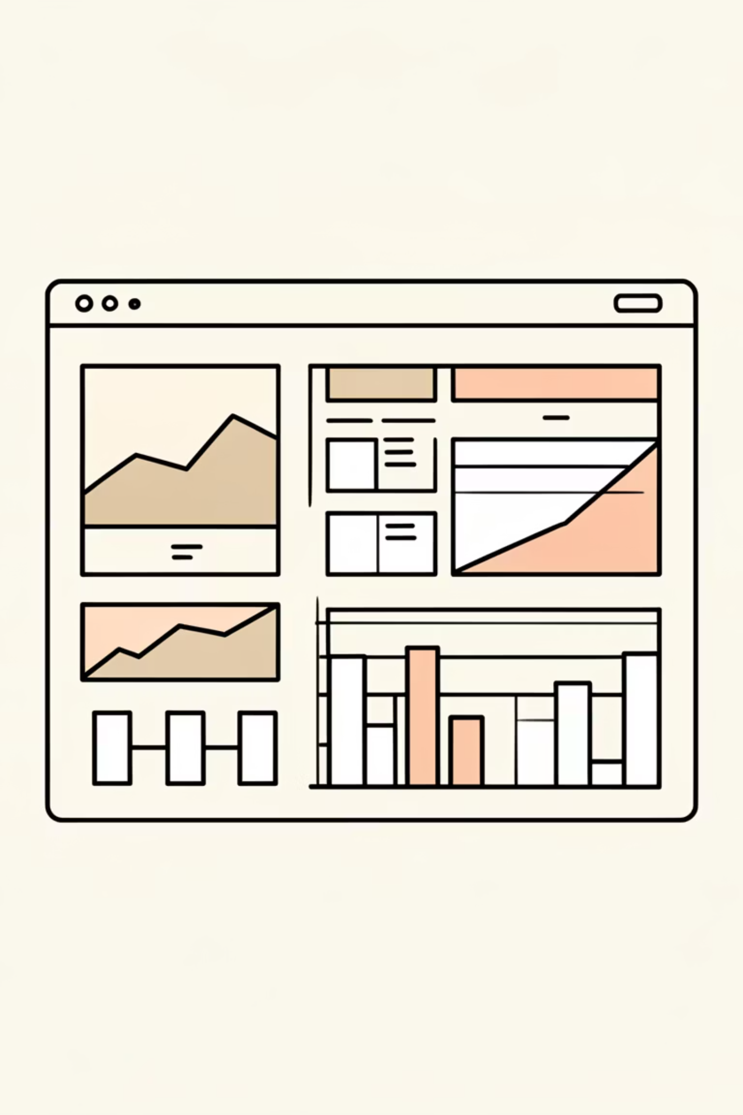
Customer Shopping Behavior Analysis
Analyzing 3,900 customer transactions to uncover insights into spending patterns, customer segments, and product preferences that could inform business decisions.

Slide 2
DATASET OVERVIEW
The Foundation: Our Data
3,900
18
50
25
Total Purchases
Data Points
Locations
Products
Transactions analyzed across all categories
Features covering demographics and behavior
Geographic diversity in customer base
Unique items across four categories
Dataset includes customer demographics, purchase details, shopping behavior, and subscription status. Only 37 missing values found in Review Rating column.

Slide 3

PYTHON ANALYSIS
Data Preparation & Cleaning
01
02
03
Data Loading & Exploration
Missing Data Handling
Feature Engineering
Imputed Review Rating nulls using median rating per product category
Created age_group bins and purchase_frequency_days from transaction data
Imported dataset using pandas, examined structure with df.info() and summary statistics
04
05
Data Standardization
Database Integration
Renamed columns to snake_case, dropped redundant promo_code_used field
Connected to MySQL and loaded cleaned DataFrame for SQL analysis

Slide 4
SQL INSIGHTS
Key Business Findings
Revenue by Gender
High-Value Discount Users
Male customers generated $157,890 vs. Female $75,191 in total revenue
839 customers used discounts but still spent above average purchase amount
Top Rated Products
Shipping Preferences
Gloves (3.86), Sandals (3.84), and Boots (3.82) lead in customer satisfaction
Express shipping users spend $60.48 avg vs. $58.46 for Standard

Slide 5


Subscription Analysis
27%
73%
Subscribers
Non-Subscribers
1,053 customers with active subscriptions
2,847 customers without subscriptions
Average Spend
Total Revenue
Repeat Buyers
Subscribers: $59.49
Subscribers: $62,645
958 subscribers have 5+ purchases vs. 2,518 non-subscribers
Non-subscribers: $59.87
Non-subscribers: $170,436

Slide 6



Customer Segmentation Insights
New
1
83 customers
Returning
2
701 customers
Loyal
3
3,116 customers
The majority of our customer base falls into the Loyal segment, representing customers with consistent purchase history. This strong foundation provides opportunities for subscription conversion and upselling strategies.

Slide 7

PRODUCT PERFORMANCE
Top Products by Category
1
2
Accessories
Clothing
Jewelry (171 orders), Sunglasses (161), Belt (161)
Blouse (171 orders), Pants (171), Shirt (169)
3
4
Footwear
Outerwear
Sandals (160 orders), Shoes (150), Sneakers (145)
Jacket (163 orders), Coat (161)
Discount Dependency: Hat (50%), Sneakers (49.66%), and Coat (49.07%) show highest percentage of discounted purchases

Slide 8
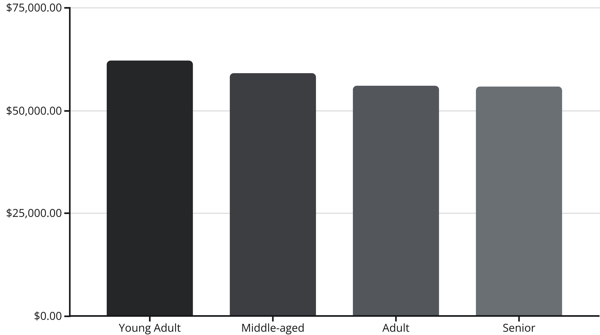
Revenue Distribution
Young Adults lead revenue generation at $62,143, followed closely by Middle-aged customers. Revenue distribution remains relatively balanced across age groups, suggesting broad market appeal.

Slide 9
POWER BI DASHBOARD
Visual Analytics Overview
3.9K Customers
$59.76 Avg Purchase
3.75 Avg Rating
Total customer base analyzed
Mean transaction value
Customer satisfaction score
Interactive dashboard enables real-time filtering by subscription status, gender, category, and shipping type for deeper analysis.

Slide 10



STRATEGIC RECOMMENDATIONS
Exploratory observations and possible next steps
Boost Subscriptions
Promote exclusive benefits to convert the 73% non-subscriber base
Loyalty Programs
Reward repeat buyers to expand the 3,116-customer Loyal segment
Optimize Discounts
Balance promotional sales with margin control on high-discount products
Product Positioning
Targeted Marketing
Highlight top-rated items (Gloves, Sandals, Boots) and best-sellers in marketing campaigns
Focus on Young Adults and express-shipping users for maximum revenue impact
This project was completed as a learning exercise to understand an end-to-end data analytics workflow. Insights are exploratory and based on the given dataset.

